Slide 1
Definition Of Binary Search Tree
A binary tree.
Each node has a (key, value) pair.
For every node x, all keys in the left subtree of x are smaller than that in x.
For every node x, all keys in the right subtree of x are greater than or equal to that in x.

Slide 2
Example Binary Search Tree
20
10
40
6
15
30
2
8
25

Slide 3
Insertion in BST
20
10
40
6
15
30
2
8
25
35
Insert 35.

Slide 4
Insertion in BST
20
10
40
6
15
30
2
8
25
35
7
Insert 7

Slide 5
Insertion in BST
20
10
40
6
15
30
18
25
35
2
8
Insert 18
7

Slide 6
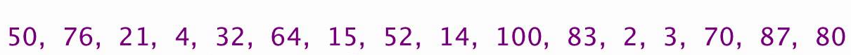
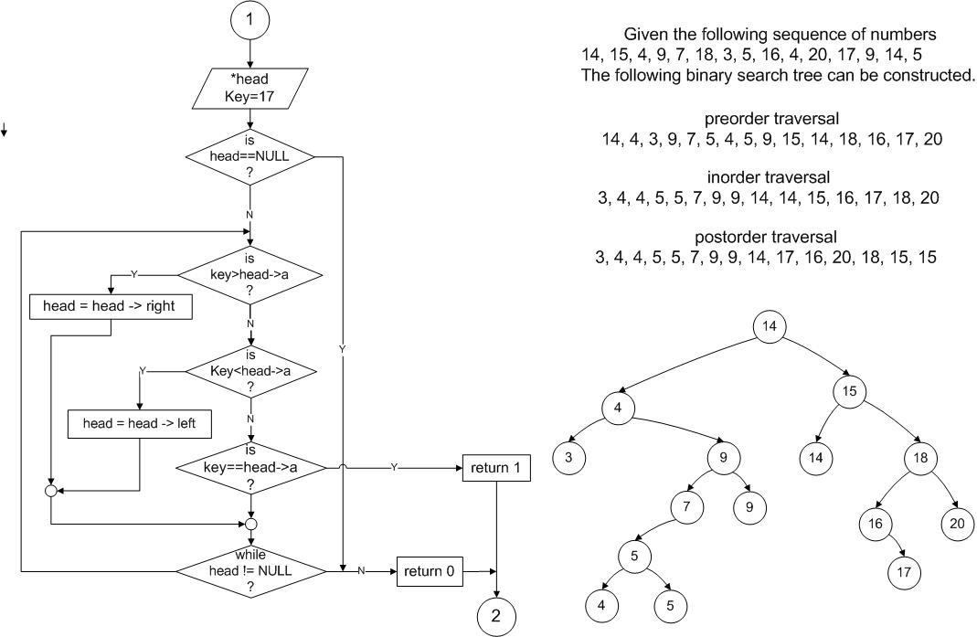
Creation of BST
Ques 1:
Ques 2:

Slide 7
Creation of BST

Slide 8
Search (Root, key)
/* return a pointer to the node that
contains key If there is no such contains key. If there is no such
node, return NULL */
Step 1. If ( Root = = NULL)
return NULL
End If
Step 2. If (key = = Root.Data)
return Root
End If
Step 3. If (key < Root.Data)
return search (Root.Left, key)
Else
return search (Root.Right, key)
End If
Step 4. Exit

Slide 9
Deletion in BST
Three cases:
  Element is a leaf.
  Element is a degree 1 node.
  Element is a degree 2 node.
Notes:
Case 1, either do nothing or report an error.

Slide 10
Delete From A Leaf
20
10
40
6
15
30
18
25
35
2
8
7
Delete a leaf element 7

Slide 11
Delete From A Leaf (contd.)
20
10
40
6
15
30
18
25
35
2
8
7
Delete a leaf element 35

Slide 12
Delete From A Degree 1 Node
20
10
40
6
15
30
18
25
35
2
8
7
Delete 40

Slide 13
Delete From A Degree 1 Node (contd.)
20
10
40
6
15
30
18
25
35
2
8
Delete 15
7

Slide 14
Delete From A Degree 2 Node
20
10
40
6
15
30
18
25
35
2
8
7
Delete 10

Slide 15
Delete From A Degree 2 Node
20
10
40
6
15
30
18
25
35
2
8
7
Replace with largest key in left subtree (or smallest in right subtree).

Slide 16
Delete From A Degree 2 Node
20
10
40
6
15
30
18
25
35
2
8
7
Replace with largest key in left subtree (or smallest in right subtree).

Slide 17
Delete From A Degree 2 Node
20
8
40
6
15
30
18
25
35
2
8
7
Replace with largest key in left subtree (or smallest in right subtree).

Slide 18
Delete From A Degree 2 Node
20
8
40
6
15
30
18
25
35
2
8
7

Slide 19
Another Delete From A Degree 2 Node
20
10
40
6
15
30
18
25
35
2
8
7
Delete 20

Slide 20
Delete From A Degree 2 Node
20
10
40
6
15
30
18
25
35
2
8
7
Replace with largest in left subtree.

Slide 21
Delete From A Degree 2 Node
20
10
40
6
15
30
18
25
35
2
8
7
Replace with largest in left subtree.

Slide 22
Delete From A Degree 2 Node
18
10
40
6
15
30
18
25
35
2
8
7
Replace with largest in left subtree.

Slide 23





Insertion BST (Root, data)
Create New node, temp.
temp.data = data
temp.left = NULL
temp.right = NULL
2. // If tree is empty
If (Root = = NULL)
Root = temp
Else
a. current = Root
b. parent = NULL

Slide 24
c. Repeat while(1) do
parent = current
If (data < parent.data) then //go to left of the tree
current = current.left
//insert to the left
If(current = = NULL) then
parent.left= temp;
return;
Else //go to right of the tree
current = current.right
//insert to the right
If (current = = NULL) then
parent.right = temp
return
End If
EndIf
End Loop
EndIf

Slide 25













